Slide 1
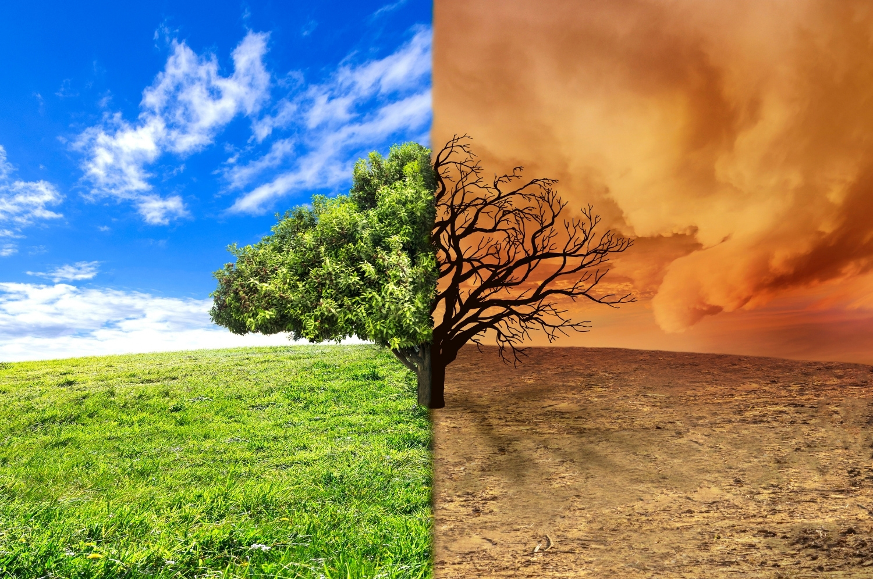


GLOBAL WARMING SOLUTIONS
ECA Project 2023-1-BG01-KA220-SCH-000160813

Slide 2


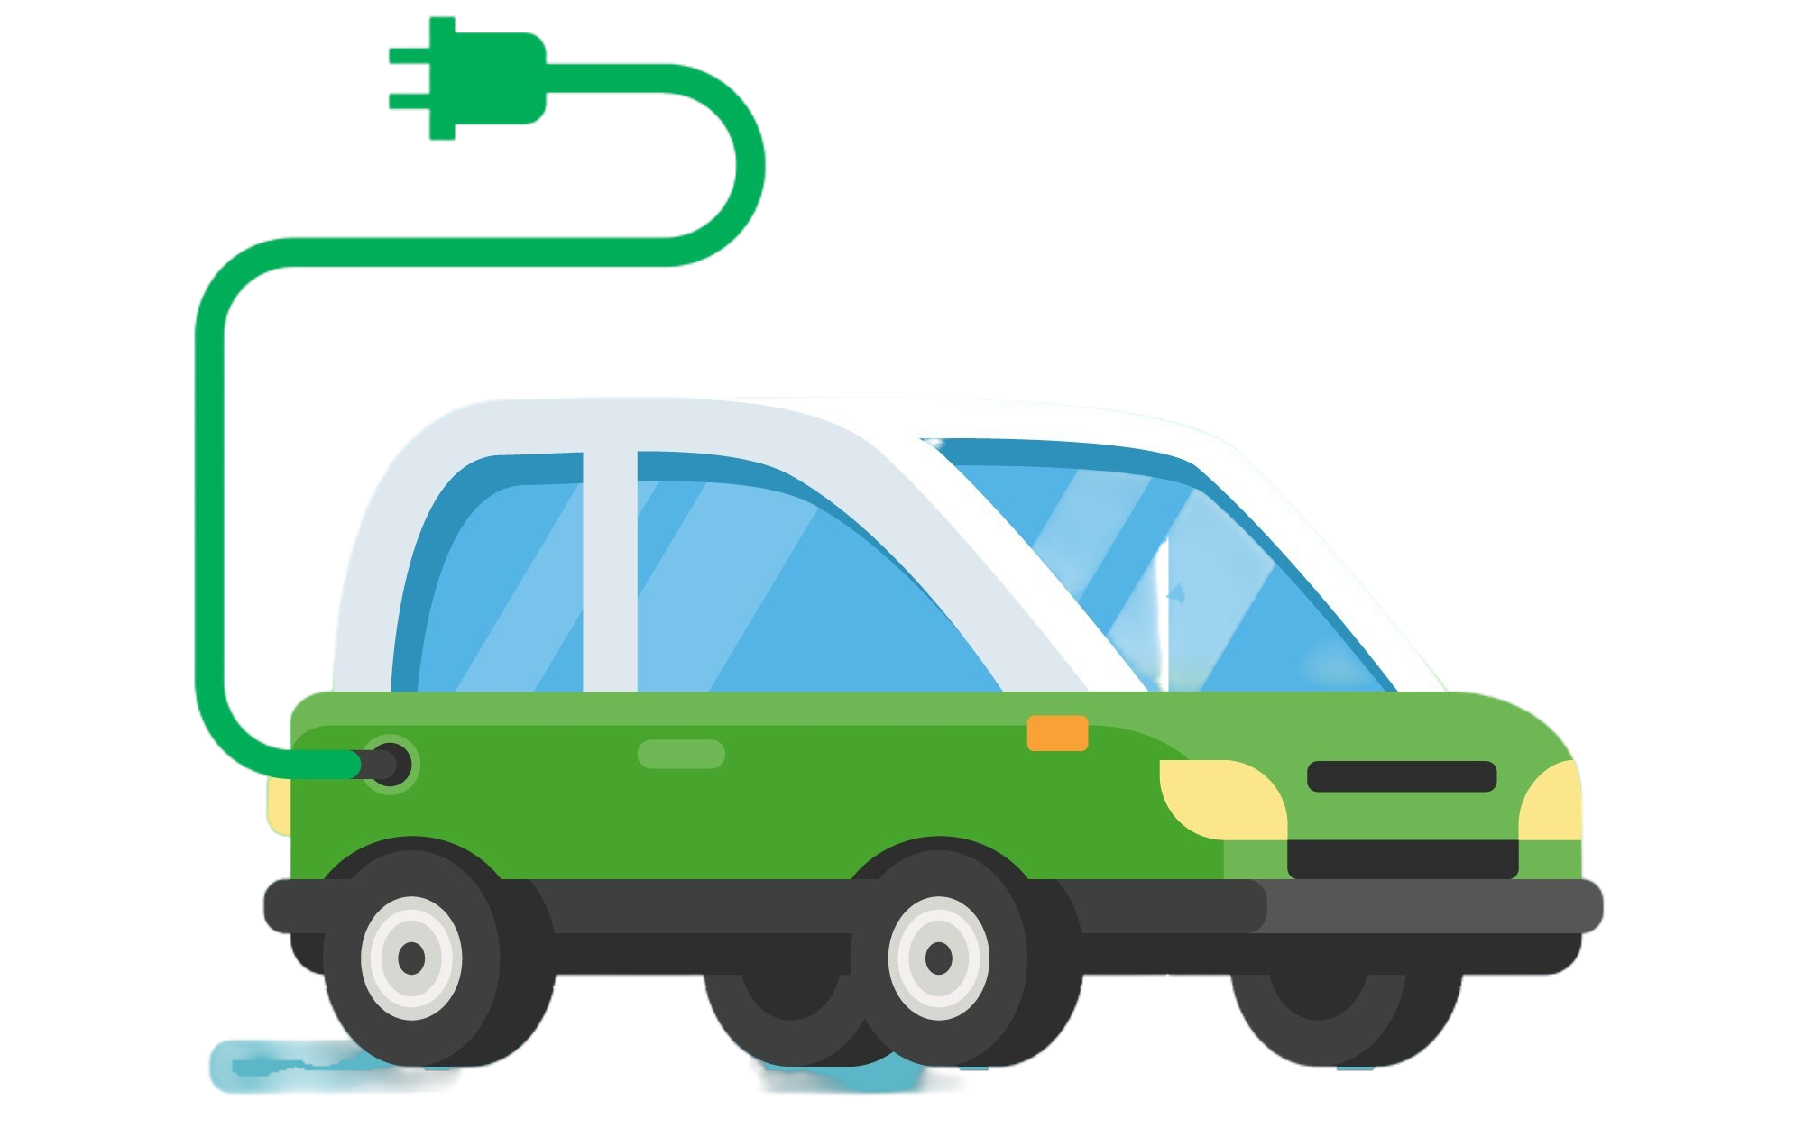
GLOBAL WARMING SOLUTIONS
Electric Car

Slide 3
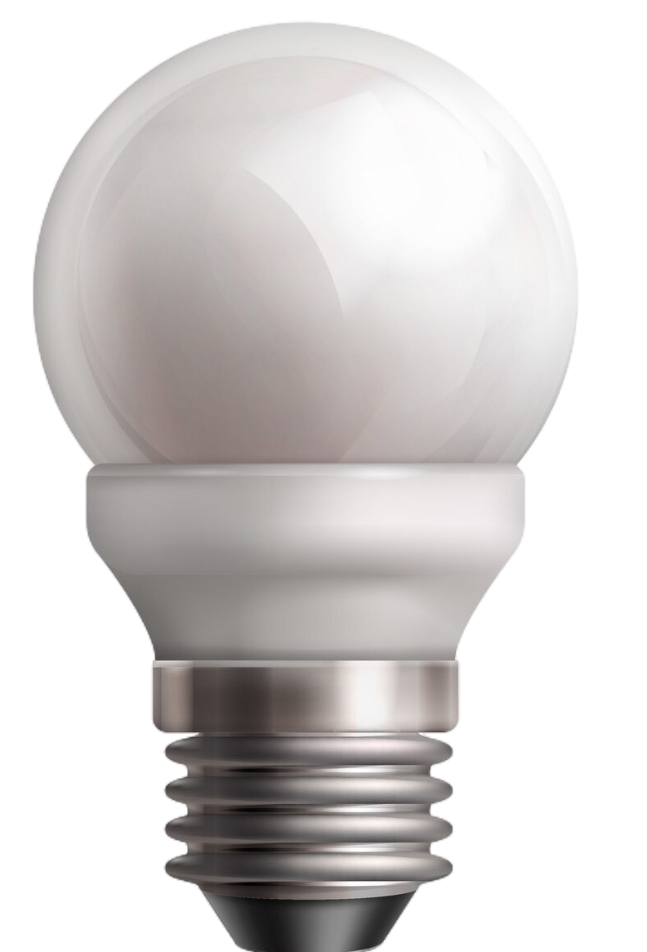
GLOBAL WARMING SOLUTIONS
Led Light Bulb

Slide 4

GLOBAL WARMING SOLUTIONS
Nuclear Plant

Slide 5

GLOBAL WARMING SOLUTIONS
Solar Energy / Solar Power

Slide 6

GLOBAL WARMING SOLUTIONS
Wind Energy / Wind Power

Slide 7

GLOBAL WARMING SOLUTIONS
Plant Trees

Slide 8

GLOBAL WARMING SOLUTIONS
Recycle

Slide 9






Module: Ecological awareness
Sub-module: Environmental pollution
Topic: Air and Climate (Global warming)
Resource title: Presentation
Credits: APDNE
2023-1-BG01-KA220-SCH-000160813
All media are within the EU intellectual property law.
Funded by the European Union. Views and opinions expressed are however those of the author(s) only and do not necessarily reflect those of the European Union or the European Education and Culture Executive Agency (EACEA). Neither the European Union nor EACEA can be held responsible for them.

